Slide 1
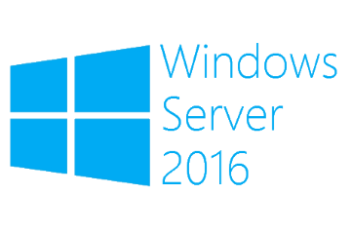
iSCSI Target
Megaseries

Slide 2
Intro
First came out as an add-on feature for Windows Server 2008 R2 and was made a built-in feature in Windows Server 2012
Allows a Windows server to serve block storage to other servers over TCP/IP
Starting with Windows Server 2012 R2 you can use VHDX files as the disk behind the block storage and these disks can be resized online

Slide 3
Terms
iSCSI Target: Runs on the iSCSI server, manages communication with clients and offers the block storage to them
iSCSI Initiator: A component on client servers that connect to the target
iSCSI virtual disk: Also knows as a LUN; It is the disk that the initiator mounts that is backed on the target by a VHD/VHDX file
IQN: This is a unique identifier for targets and initiators used in their communication and in filtering which initiator can mount a specific virtual disk

Slide 4

https://www.youtube.com/channel/UCcZ-jLbPwNr8E_v9-65n8Iw https://github.com/itknowledge4

